Slide 1
Model Compression

Slide 2
Outline
Background
Knowledge distillation
Pruning
Lightweight model design

Slide 3
Why model compression?
It is a challenge to deploy a large deep models on devices with limited resources, e.g., mobile phones and embedded devices.
A variety of model compression and acceleration techniques have been developed:
Pruning
Quantization(立平)
Knowledge distillation
Lite weight model design
Neural Architecture Search (NAS)

Slide 4
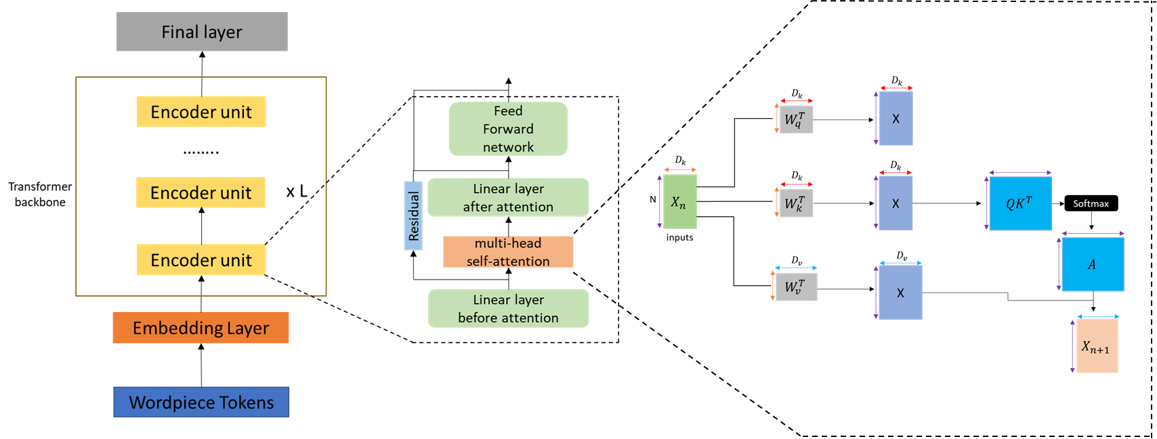
BERT Architecture
Bidirectional Encoder Representations from Transformers(BERT)
BERT is based on the transformer architecture, a sequence to sequence model that uses self-attention mechanisms
BERT has achieved state-of-the-art results on numerous NLP benchmarks
Consist of multiple layers where each layer contains multiple self-attention heads
BERT requires significant computational resources for training and inference
BERT reads text inputs in both directions
J. Devlin, M.-W. Chang, K. Lee, and K. Toutanova, BERT: Pre-training of Deep Bidirectional Transformers for Language Understanding ACL2019
Notes:
Previous models read text input in one direction (either left-to-right or right-to-left),

Slide 5
Outline
Background
Knowledge distillation
Pruning
Lightweight model design

Slide 6
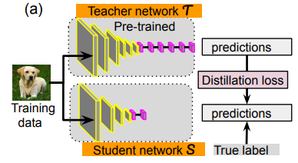
Knowledge distillation
When training a small model, distill some information from the large model
such as the probability distribution of the prediction to help the small model learn better
KL Divergence
(Soft label)
Cross Entropy
(Hard label)

Slide 7

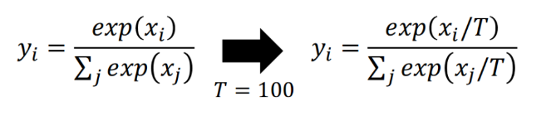
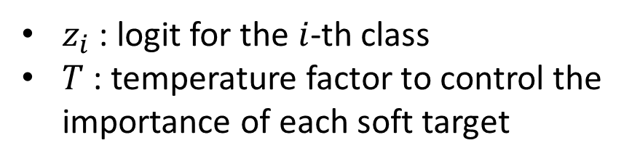
Soft label Distillation loss function
Soft label and temperature
$z_{i}$ : logit for the $i$-th class
$T$ : temperature factor to control the importance of each soft target
T | Logits | Softmax Probabilities
1 | [30, 2, 1.9] | [1.0e+00, 6.9e-13, 6.9e-13]
10 | [3, 0.2, 0.19] | [0.892, 0.0542, 0.0537]

Slide 8



Soft label Distillation loss function (cont.)
Soft target
Hard label
Total loss: ${a L}_{R}+{(1−a)L}_{CE}$

Slide 9
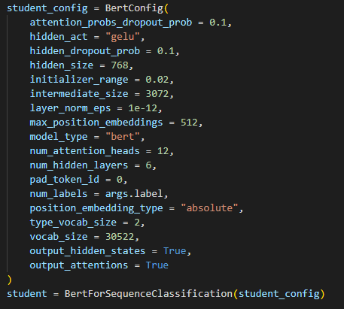
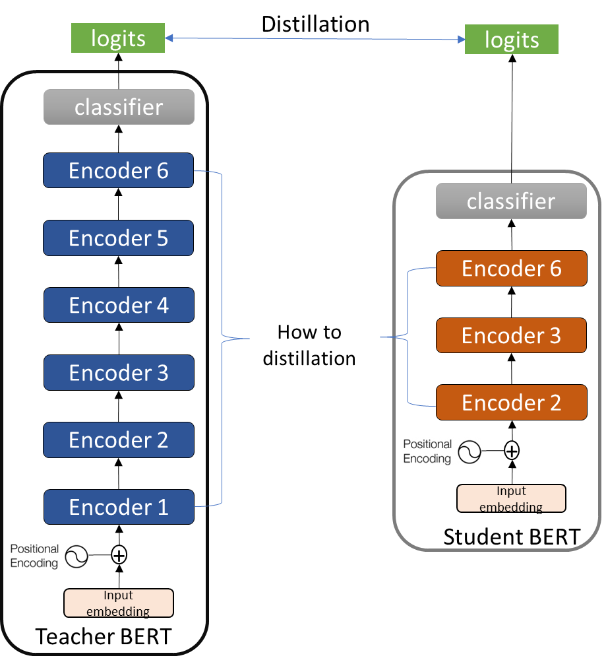
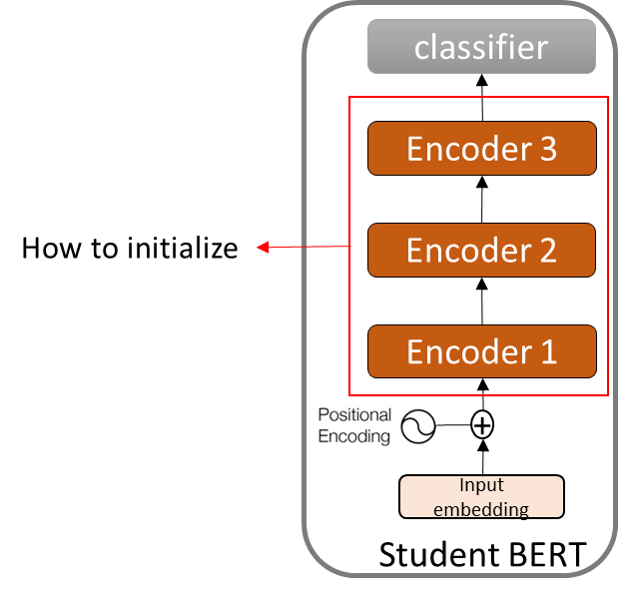
Distillation step
Step
Define student model
Initial weight
Training
(1)
(2)
(3)

Slide 10
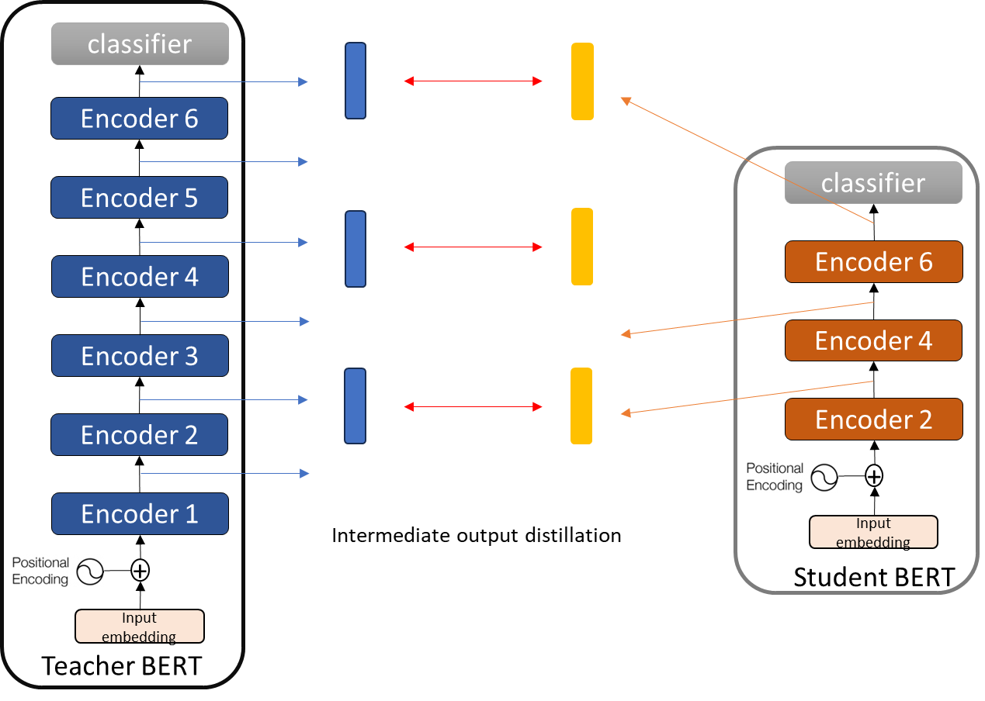
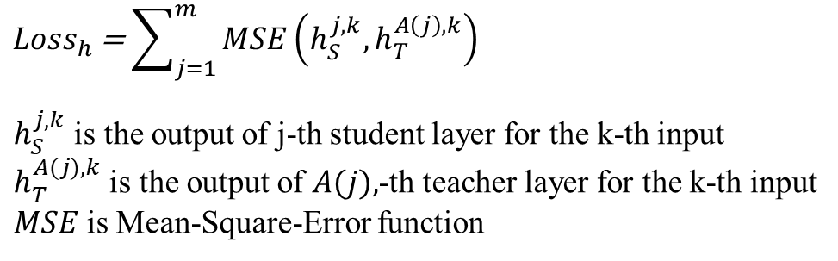
BERT Distillation

Slide 11
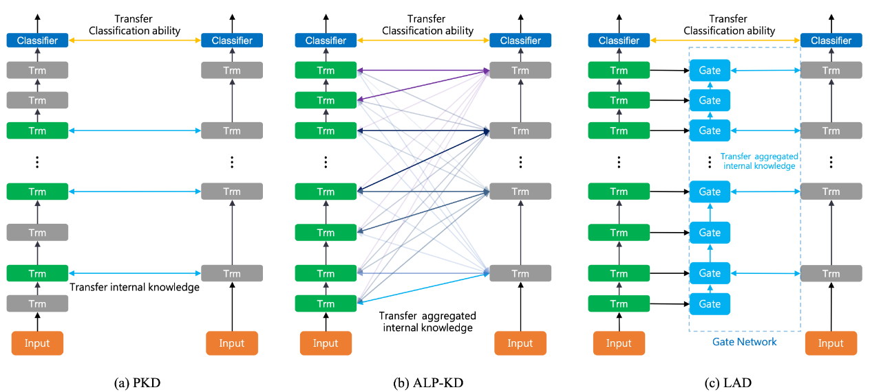
BERT Distillation
ALP-KD: Attention-Based Layer Projection for Knowledge Distillation
Layer-Wise Adaptive Distillation for BERT Model Compression

Slide 12
Outline
Background
Knowledge distillation
Pruning
Lightweight model design

Slide 13
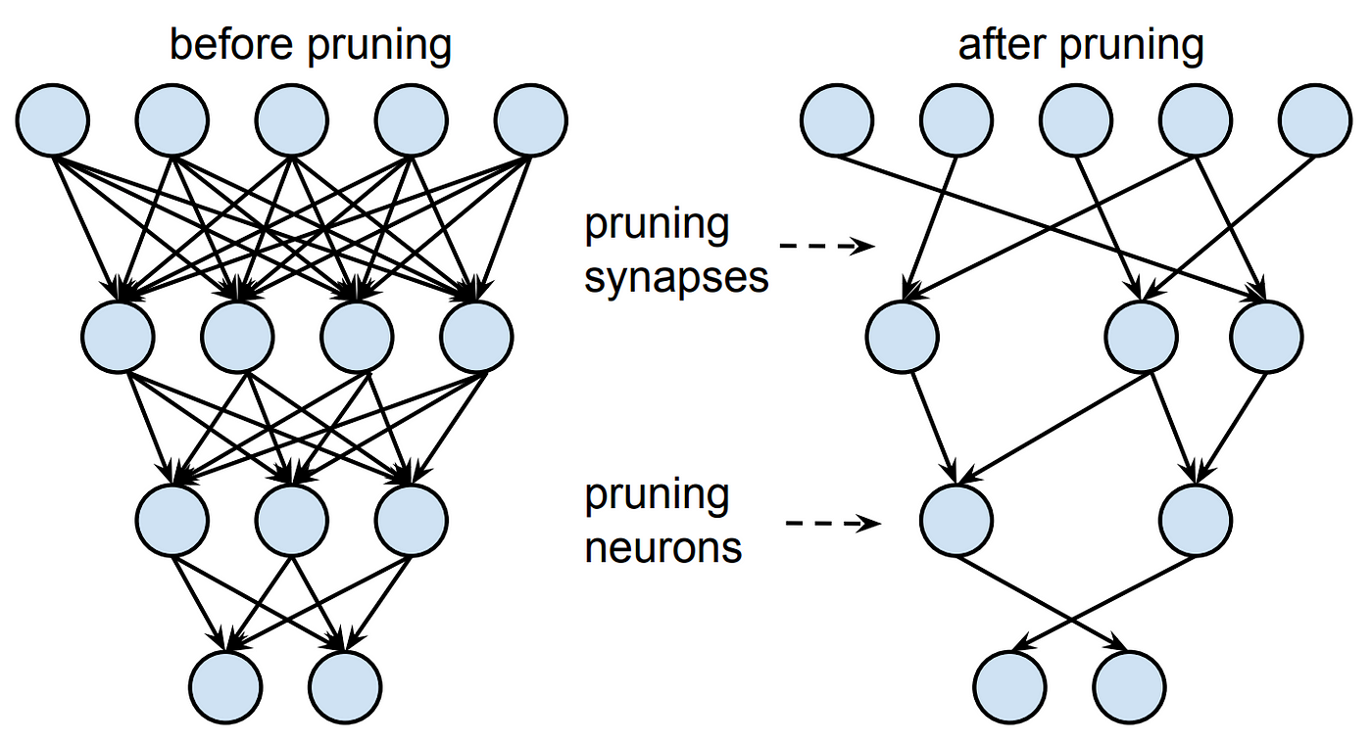
Network Pruning
Networks are typically over-parameterized(there is significant redundant weight or neurons)
Prune them

Slide 14
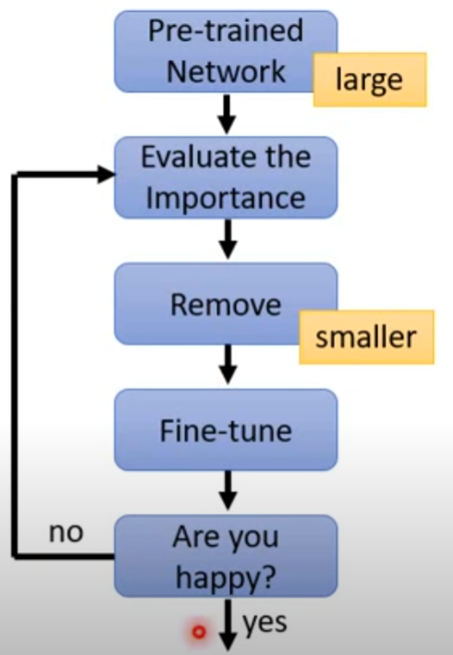

Network Pruning
Importance of a weight:
L1, L2……..
After pruning, the accuracy will drop
Fine-tuning on training data for recover
Don’t prune too much at once, or the network won’t recover.

Slide 15
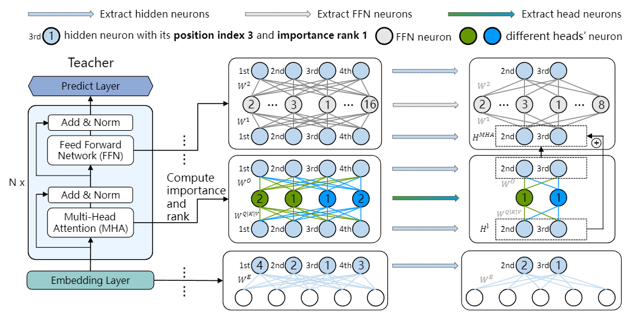
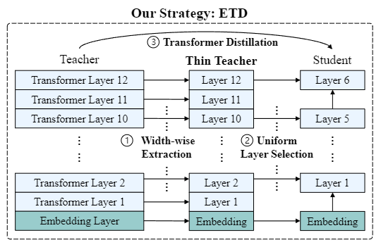
BERT Pruning
Calculate the importance of a neuron by the impact on the pre-training loss
Follow the principle of hidden consistency
Extract then Distill: Efficient and Effective Task-Agnostic BERT Distillation

Slide 16
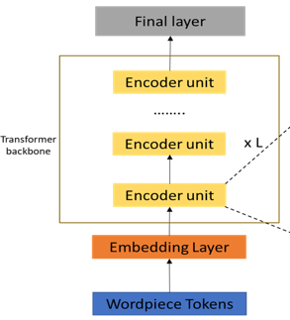
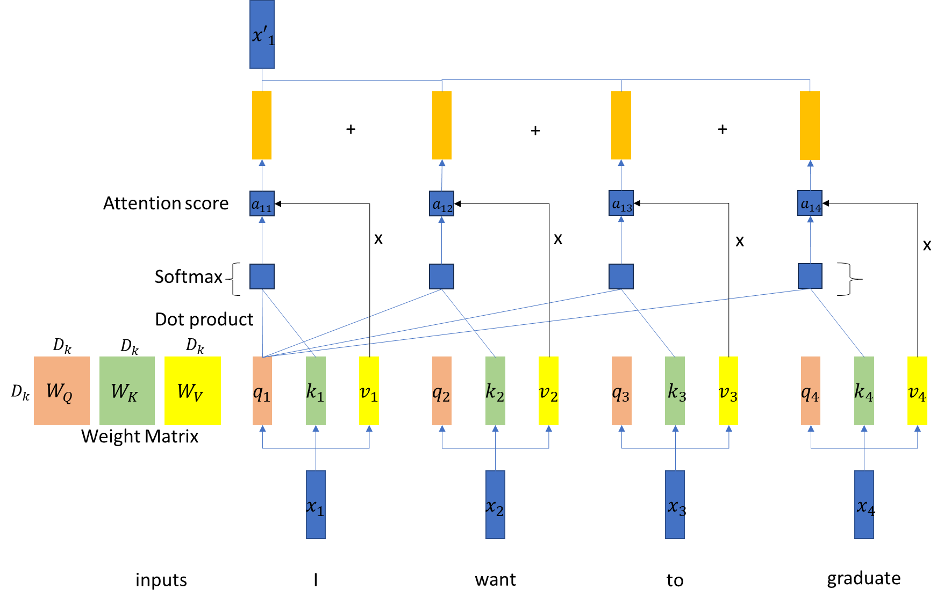
BERT Pruning
52
Word Embedding
768
35022
52
Input token

Slide 17
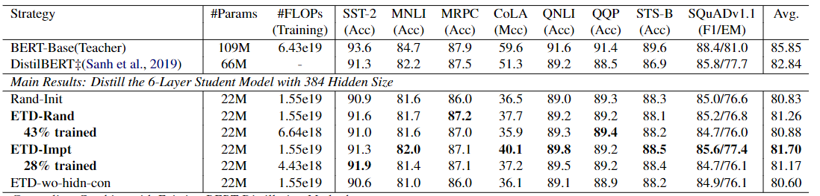
BERT Pruning
Extract then Distill: Efficient and Effective Task-Agnostic BERT Distillation

Slide 18
Outline
Background
Lite weight model design
Knowledge distillation
Lightweight model design

Slide 19
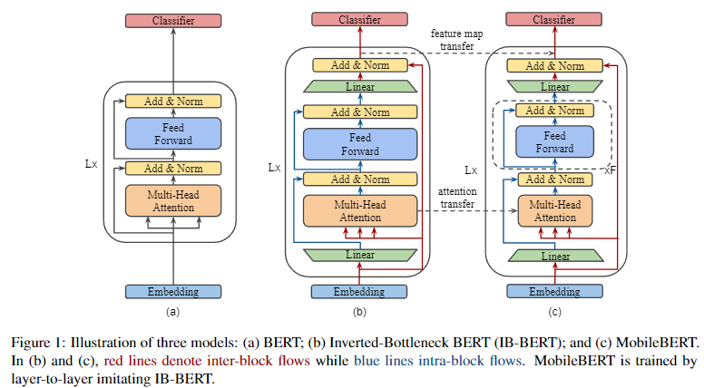
MobileBERT
Redesign the model, so we don’t have good weight to initialize the model
Hard to training
MobileBERT training resource
256TPU v3 chips for 500k steps with batch size 4096

Slide 20
Q&A

Slide 21
Homework – BERT Knowledge Distillation
Task: Determine whether one sentence is a paraphrase of another
Dataset: MRPC
You need to do:
Directly training a small BERT(6-layer encoder layer)
Use the teacher model(12-layer) weight to initial the student model and training
One out of two
Knowledge Distillation
Intermediate hidden state (ClS token)
Output distribution
Save your trained model and calculate f1 score

Slide 22
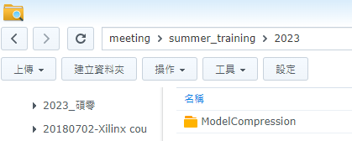
Homework

Slide 23
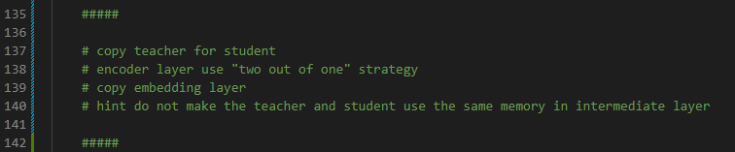
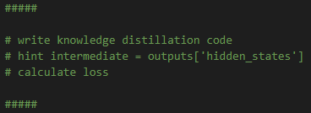
Homework: hint
Run the code
You should modify the code:
main_BERT.py
Header/Runner.py

